Slide 1
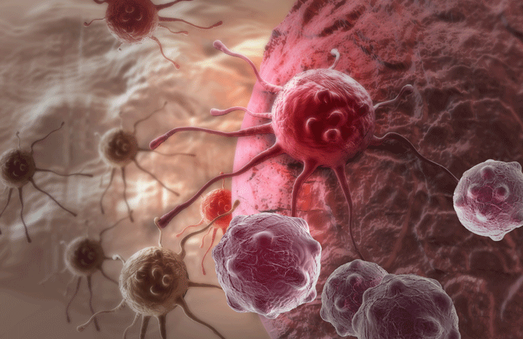
Introduction
Layer classification by analyzing cell migration data
By Dogan Askan
*http://www.epmmagazine.com/news/drug-combo-shrinks-melanomas/
Notes:
My problem is layer classification of the surfaces where cells migrate. I have analyzed data sets obtained from cells’ movement on different layers. Data sets have only velocity information of the cells. I have tried to analyze this data sets to classify different layer types by using clustering algorithms.

Slide 2
Cell Behavior Analysis
K-Means Clustering
Do cell’s migration differ depending on the surface type?
The answer is “Yes”.
But only for some.
Notes:
I have used k-means clustering method for clustering. And, I have tried to answer the question “Do cell’s migration differ depending on the surface type?”
The answer is “Yes”.
But not all of them, I could only have classified some. We’ll get into details in the following slides. Even though, this is an unsupervised learning problem, I prefer to use the term “classify”. Because, we have sort of initial insights that some of the surfaces allow cells move faster than the others.

Slide 3
Data
Provided by Professor Shantanu Sur at Department of Biology
5 layers → 2 sample sets → 10 cells → 40 observations → total 4000 instances
Cell 1 | Cell 2 | Cell 3 | Cell 4 | Cell 5 | Cell 6 | Cell 7 | Cell 8 | Cell 9 | Cell 10
0.144 | 0.144 | 0.329 | 0.204 | 0.465 | 0.233 | 0.322 | 0.129 | 0 | 0.258
0.658 | 0.266 | 0.193 | 0.193 | 0.288 | 0 | 0.258 | 0.204 | 0.408 | 0.322
0.329 | 0.504 | 0.258 | 0 | 0 | 0.193 | 0.064 | 0.233 | 0.129 | 0.555
0 | 0 | 0.064 | 0.144 | 0.091 | 0.144 | 0.322 | 0.645 | 0.532 | 0.266
0.347 | 0.322 | 0 | 0 | 0.288 | 0.532 | 0.387 | 0.064 | 0.456 | 0.288
0 | 0.387 | 0.258 | 0.064 | 0 | 0.456 | 0.532 | 0.204 | 0.376 | 0.387
0.064 | 0.266 | 0.129 | 0.064 | 0.204 | 0.52 | 0.064 | 0.456 | 0.064 | 0.288
0.064 | 0.456 | 0.322 | 0.129 | 0.064 | 0.274 | 0.329 | 0.064 | 0.129 | 0.129
0.129 | 0.233 | 0 | 0.204 | 0.288 | 0 | 0.258 | 0.204 | 0.433 | 0.465
0 | 0.144 | 0.144 | 0.322 | 0.129 | 0.451 | 0.064 | 0.288 | 0.182 | 0.491
0.064 | 0.376 | 0 | 0.266 | 0.233 | 0 | 0.387 | 0.322 | 0.288 | 0.577
0 | 0 | 0.182 | 0.347 | 0.129 | 0 | 0.129 | 0.516 | 0.347 | 0.091
0 | 0.064 | 0.465 | 0.258 | 0.129 | 0.392 | 0.376 | 0.144 | 0.433 | 0.413
0.266 | 0.274 | 0 | 0.322 | 0.182 | 0 | 0.376 | 0 | 0.144 | 0.322
0.182 | 0.258 | 0.129 | 0 | 0.288 | 0.451 | 0.274 | 0.392 | 0.064 | 0
0.408 | 0.329 | 0 | 0.329 | 0.193 | 0 | 0.064 | 0.288 | 0.233 | 0.064
0.266 | 0.504 | 0 | 0 | 0.064 | 0.433 | 0.193 | 0.555 | 0.387 | 0.129
0.182 | 0.091 | 0.193 | 1.419 | 0.144 | 0.064 | 0.258 | 0.144 | 0.233 | 0.144
0.204 | 0.233 | 0.144 | 0.456 | 0.193 | 0.52 | 0 | 0.288 | 0.274 | 0.456
EPA
FSL
PDL
RGDS
RSL
EPA-1
EPA-2
FSL-1
FSL-2
PDL-1
PDL-2
RGDS-1
RGDS-2
RSL-1
RSL-2
Notes:
So, the data is provided by Prof. Sur from Department of Biology from cancer cells movement research.
We have 5 different layer types, each type has two sample set, each sample set has 10 cells, and each cell has 40 observations in terms of velocity. So, we have total 4000 instances. 15 minutes intervals velocities.
Here is a part of the data,
As I said we have 5 types of layer need to be classified. Those abbreviations stand for some chemical terms. For example, PA is for “peptide amphiphile”, F is “forward” and R is “reverse”.
And, we have 2 sample sets for each.

Slide 4
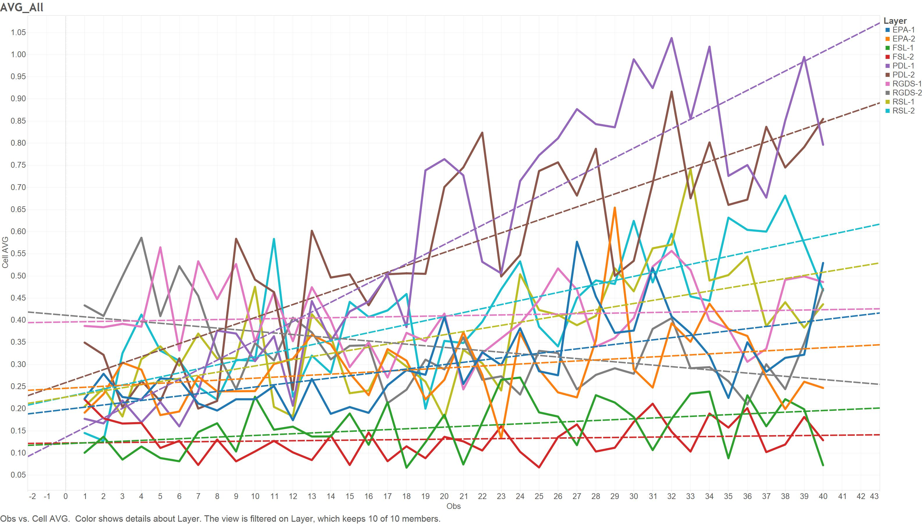
Data Visualization
Notes:
This chart shows average cells velocities throughout observations, each line represents test conditions. Remember, 2 tests for each layer, there are 10 lines here. I know it is not so easy to distinguish lines, I will clarify all in the following slides, but even here you can see some similar patterns for same layers.
Like these.

Slide 5
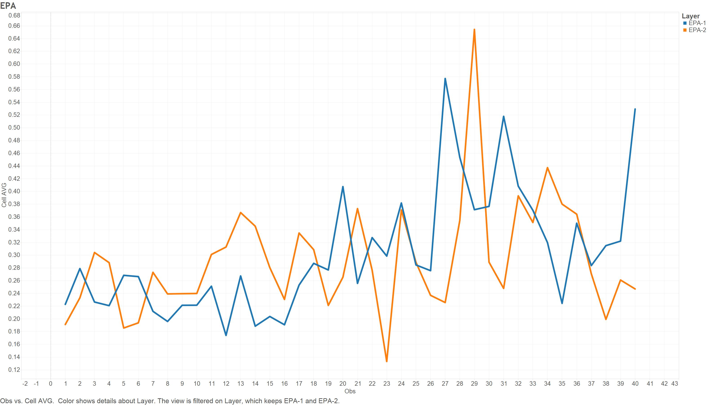
Data Visualization - EPA
Notes:
If we would like to look closer for each sets. Here is the EPA-1 and 2 velocity series throughout in 40 instances, by the way there is 15 minutes between each observations. As expected, cells behave similar in same type of surface.

Slide 6
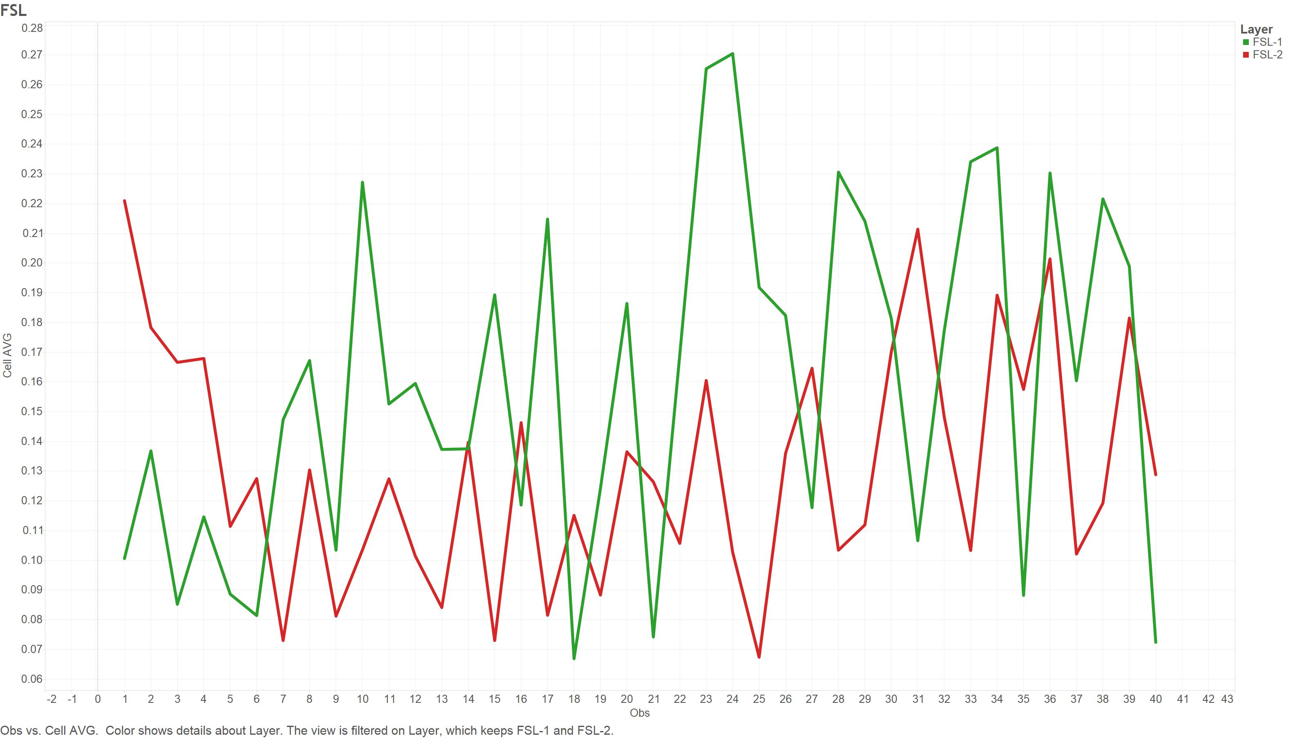
Data Visualization - FSL
Notes:
This is for FLS surface type.

Slide 7
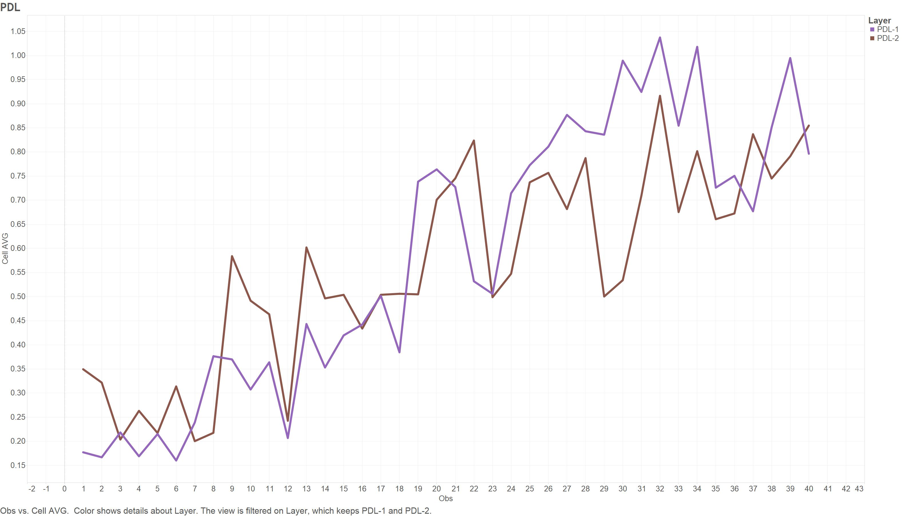
Data Visualization - PDL
Notes:
This is for PDL. And, you can also see that some are getting faster by time.

Slide 8
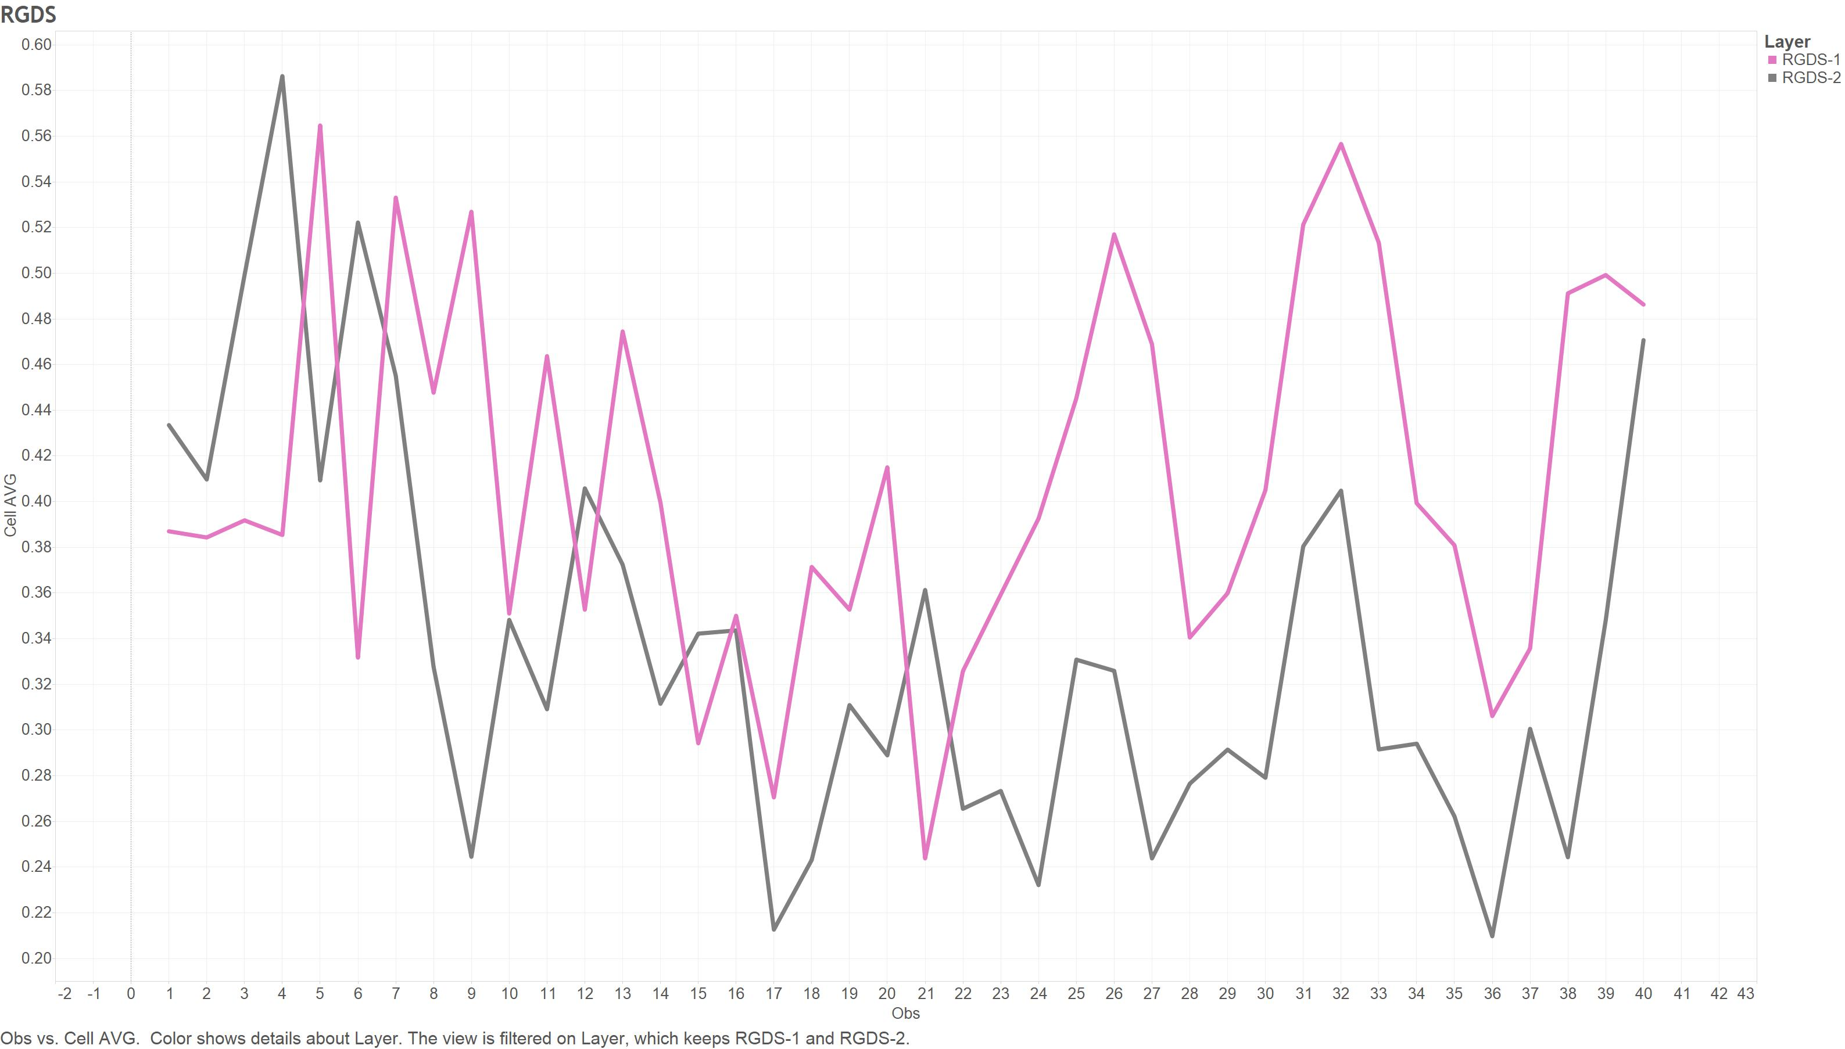
Data Visualization - RGDS
Notes:
And, some are getting slower. This is for RGDS.

Slide 9
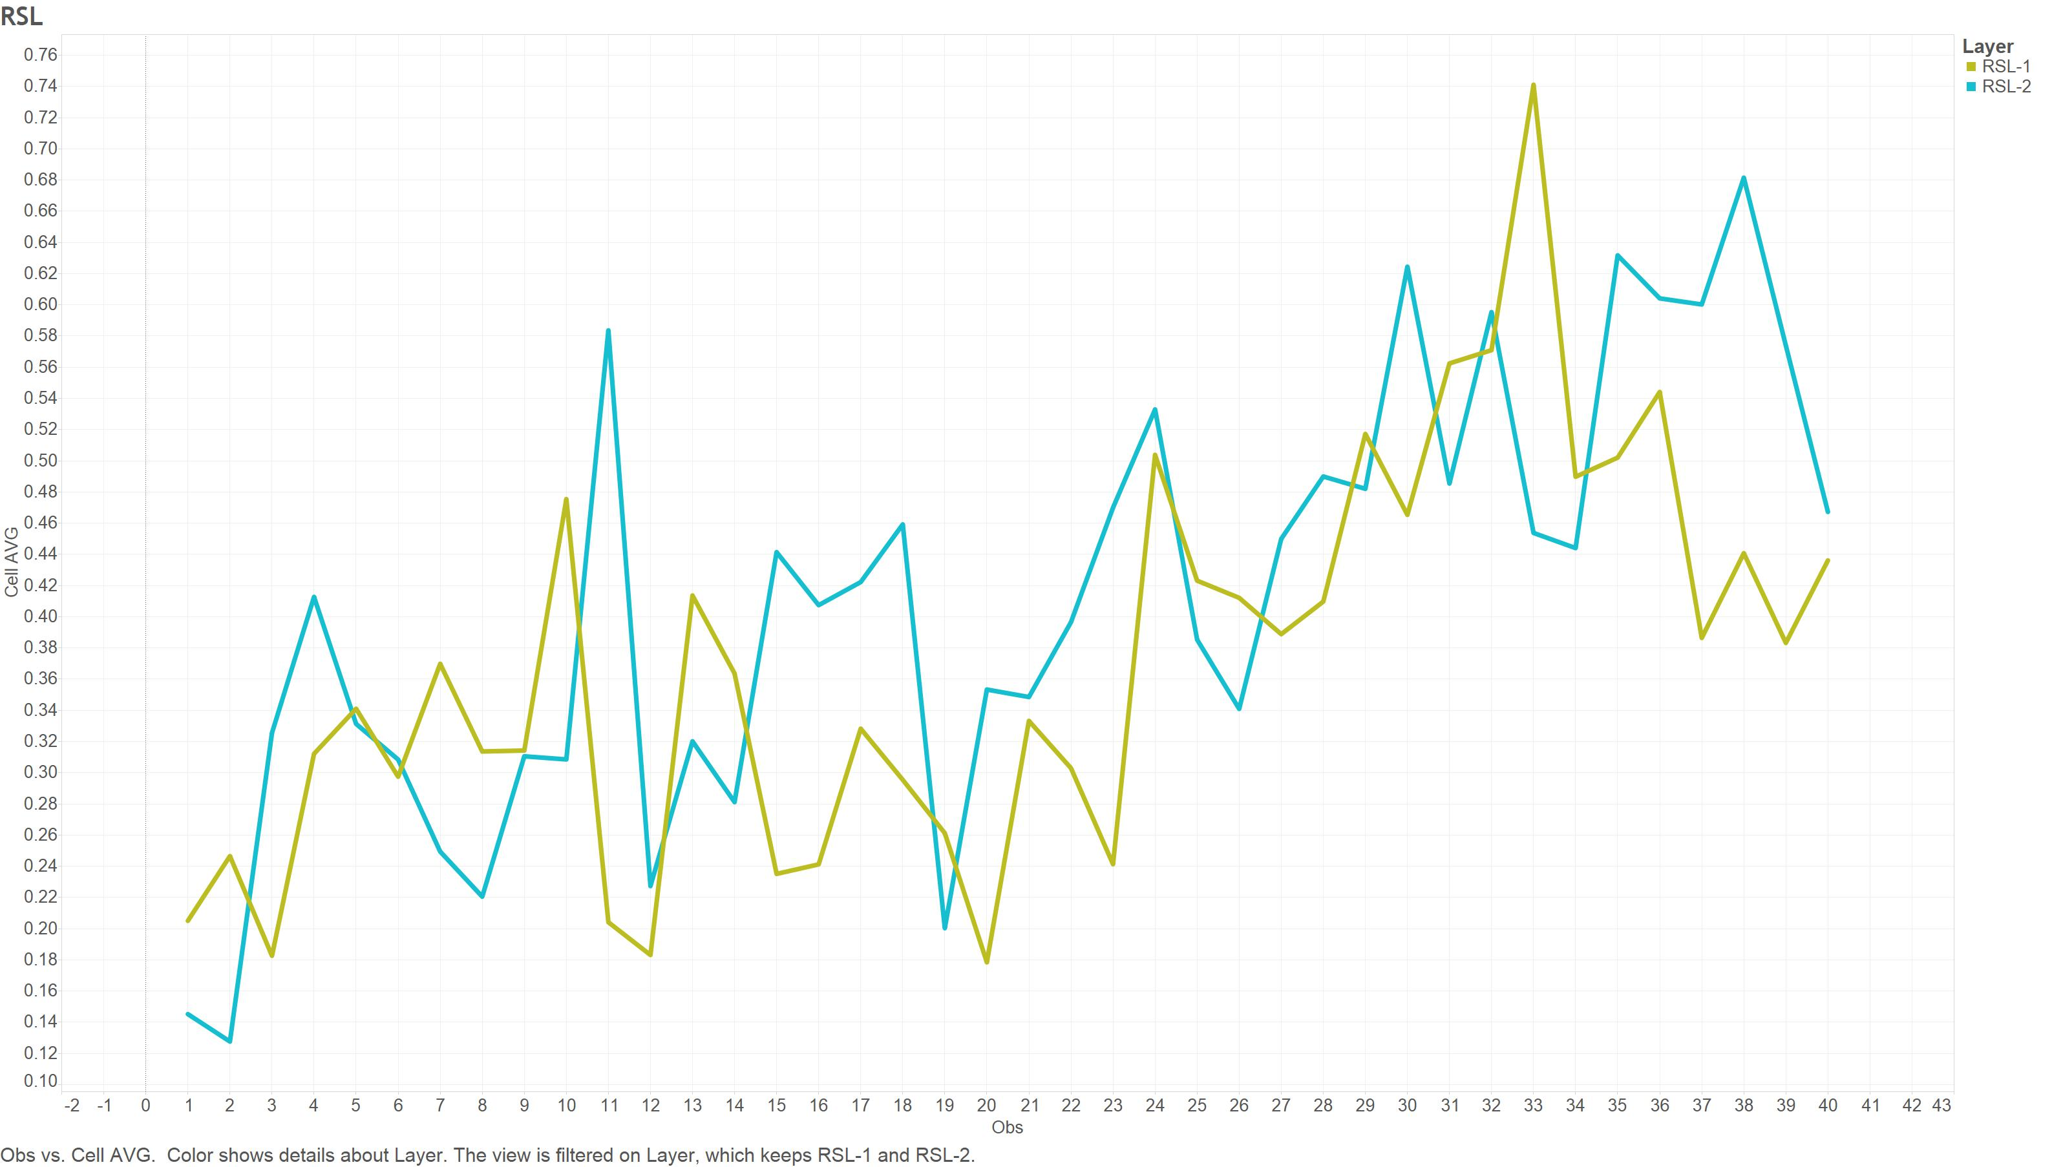
Data Visualization - RSL
Notes:
This is for RSL. Getting faster again, even though the slop is relatively small.

Slide 10
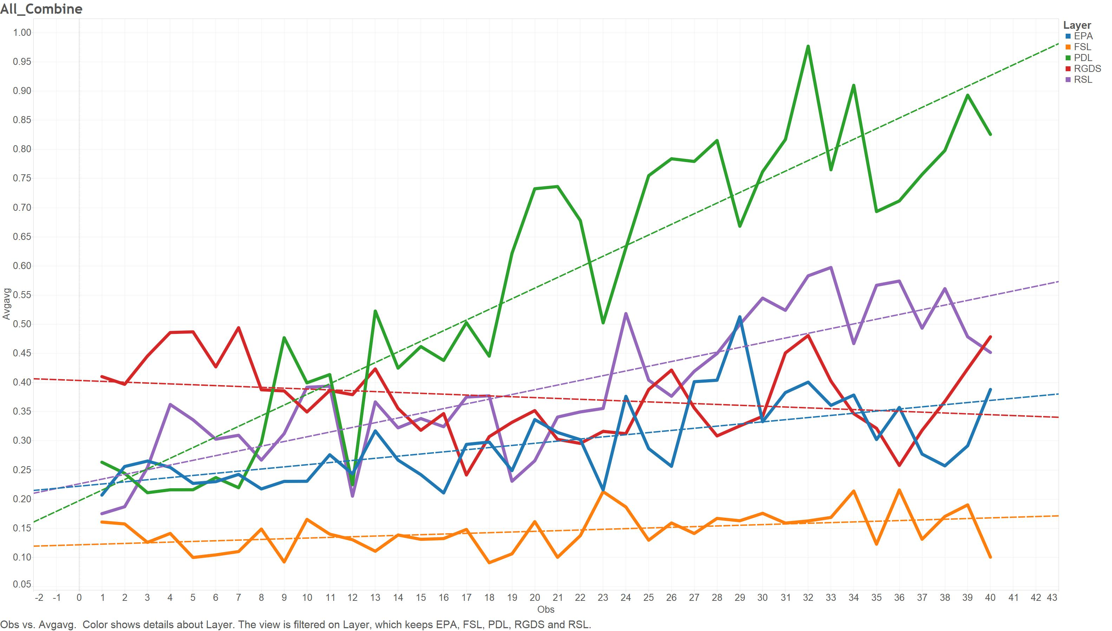
Data Visualization - Combination
Notes:
This is the combination of sample sets by average. There are only 5 different lines here to present 5 different layers.

Slide 11
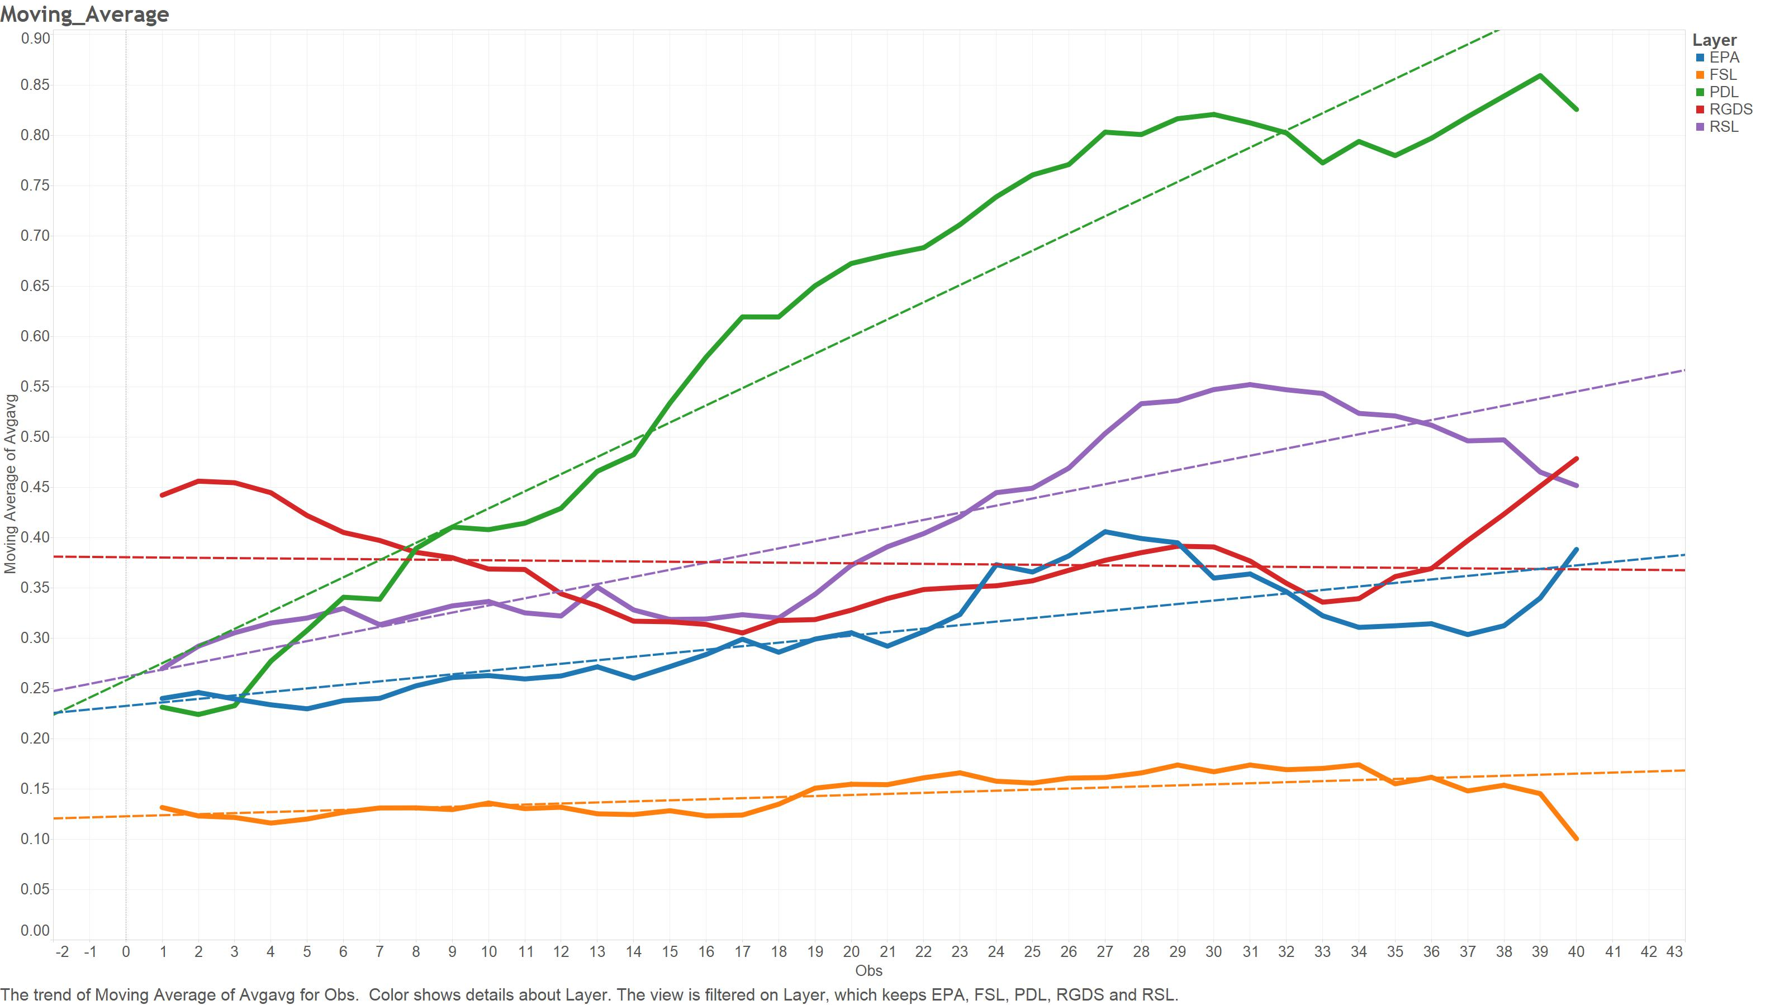
Data Visualization – Moving AVG
Notes:
To make that visualization more understandable by smoothing, I used moving averages. As you see, now the tendencies of lines, in other words velocities of cells in time, are clearer to comprehend. This graph was constructed with moving average of next 5 values. It is 5 because 5 is high enough to provide smoothness to graph, and low enough to keep variability in the data. I tried 2, 3, 8, 10 and 5:40 is the one that visualizes this graph best. And, still, you can notice some line formations hard to distinguish.
Here,
And here, these are also the parts that k-means clustering cannot cluster clearly. That is why I can classify some, not all of them.

Slide 12
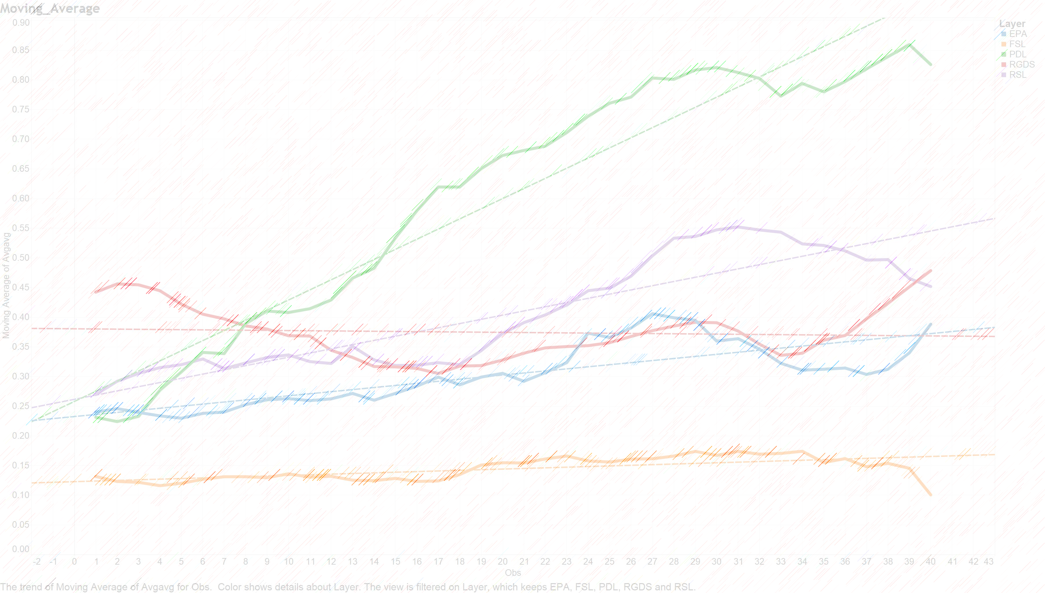
Clustering – Beginning Phase
RGDS
FSL
Notes:
And, since there are different trends through time series, I performed different clustering in two different part of the time series.
This is the first analysis, which includes between the time period of 0 and 2.5 hours.

Slide 13
Clustering – Beginning Phase
Success Ratio
90%
Notes:
The result is not bad. SPSS distinguished layers by looking a particular cell velocity distribution.
There are only 4 wrong output out of 40 instances.
So, success rate is 90% in the beginning phase of cell migration. And, visual difference is also confirmed statistically with this ratio.

Slide 14
Clustering – Maturity Phase
PDL
FSL
Notes:
Likewise, I did the analysis in the maturity phase too. Here, PDL is the fastest surface instead of RGDS in the beginning phase. This phase is between 5 – 10 hours of time series.

Slide 15
Clustering – Maturity Phase
Success Ratio
97.5%
Notes:
Same analysis, but result is better here. There is only one wrong classification here.
This one.
So, much better success rate.

Slide 16
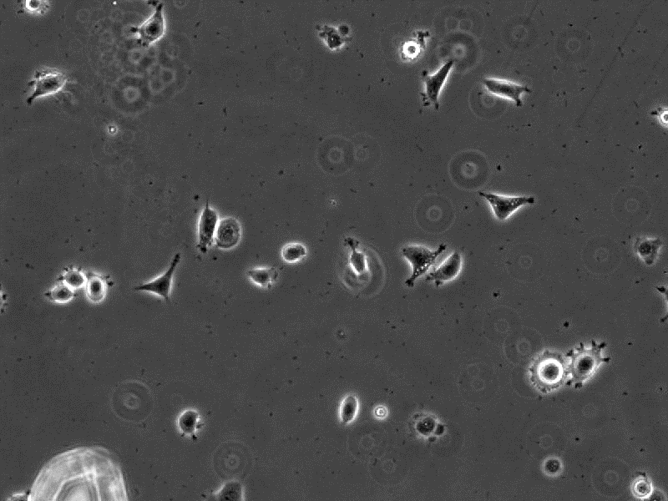
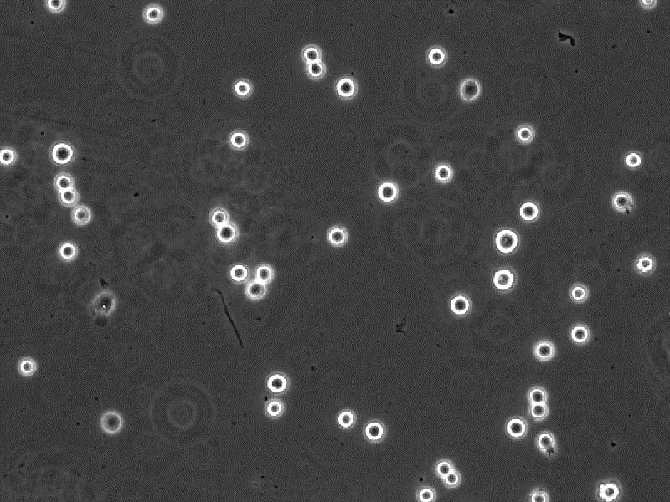
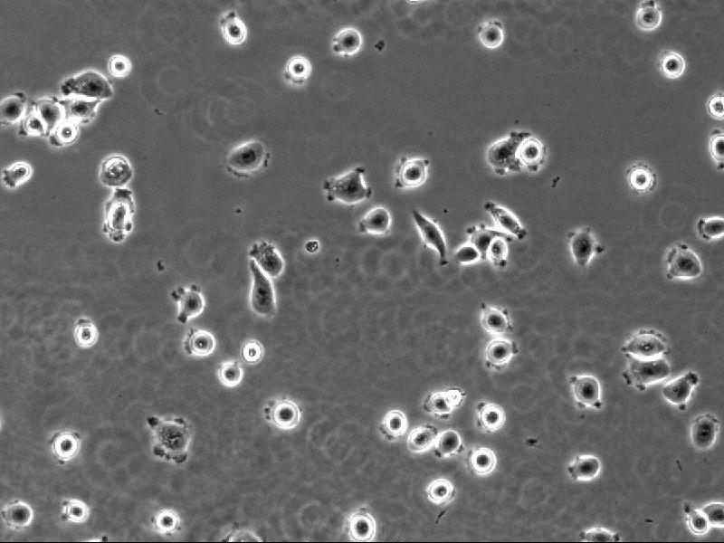
Cell Migration
RGDS
FSL
PDL
Fastest in Beginning
Slowest
Fastest in Maturity
*Media is provided by Professor Shantanu Sur, Department of Biology
Notes:
These are the actual footages of cells on aforementioned layers. You can easily see the velocity differences.

Slide 17
Insights
2 classes for beginning, 2 classes for maturity
Cells migrate significantly slower on the layer type FLS in every phase.
Cells migrate significantly faster on the layer type RGDS in beginning phase.
Cells migrate significantly faster on the layer type PDL in maturity phase.
90% success rate in the beginning phase, 97.5% in maturity.
Notes:
So, consequently, my insights are;
There are 2 classes in the beginning and maturity phases, since we have actually 5 layer types, other 3 types cannot be classified or clustered statistically.
Both statistically and visually, cells migrate significantly slower on the layer type FLS in every phase.
Likewise, cells migrate significantly faster on the layer type RGDS in beginning phase.
And, cells migrate significantly faster on the layer type PDL in maturity phase both statistically and visually.
We reached 90% success rate in the beginning phase, and 97.5% in maturity phase.
That’s all I can present. Thanks.

Slide 18
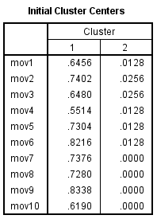
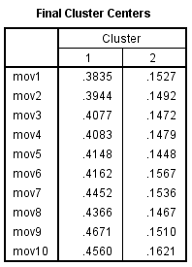
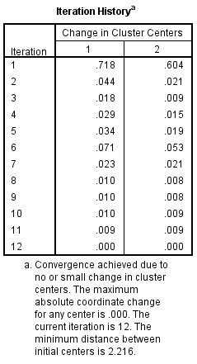
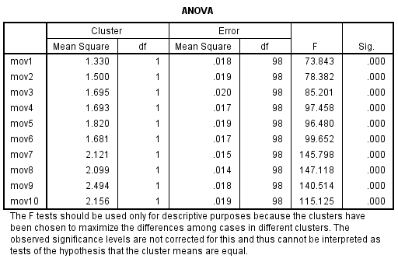
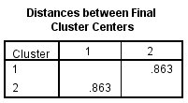
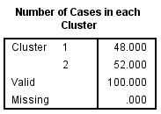
Clustering – B Phase (Back-Up)

Slide 19
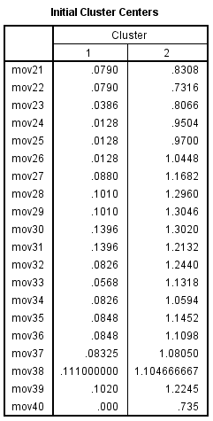
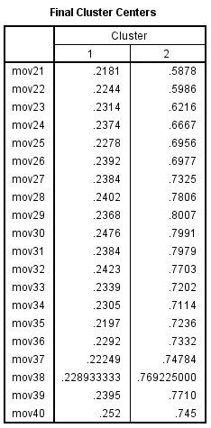
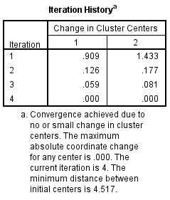
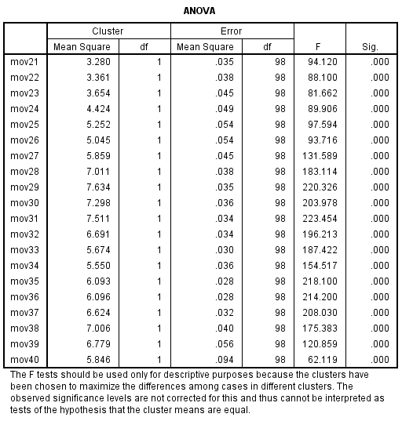
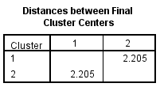

Clustering – M Phase (Back-Up)

Slide 20
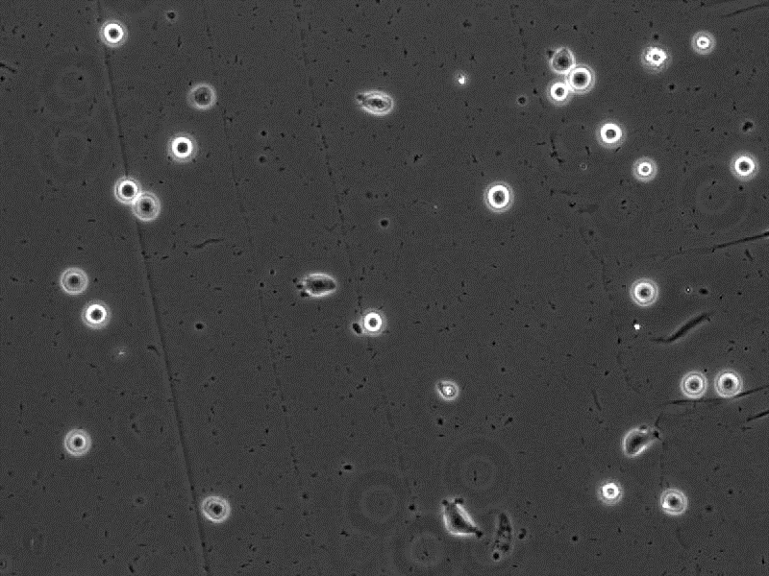
RSL Migration (Back-Up)
RSL PA: C₁₆H₃₁O-(lys)-val-val-val-ala-ala-ala-lys-lys
*Media is provided by Professor Shantanu Sur, Department of Biology

Slide 21
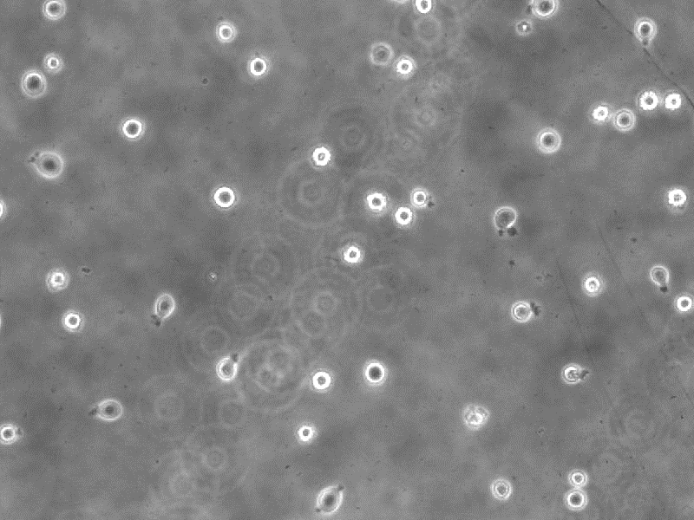
EPA Migration (Back-Up)
EPA: C₁₆H₃₁O-(εlys)-ala-ala-ala-gly-gly-gly-lys-lys
*Media is provided by Professor Shantanu Sur, Department of Biology

Slide 22
Extra Analysis (Back-Up)
EPA: C₁₆H₃₁O-(εlys)-ala-ala-ala-gly-gly-gly-lys-lys

